Slide 1
DIY Drone Kit
Fly High: Unleash Your Inner Engineer

Slide 2
Table of Contents
Raspberry Pi5 .................................................................... 3
Motors ................................................................................ 4
Motor Drivers ................................................................... 5
Power Distribution Board .............................................. 6
Battery ................................................................................ 7
Buck Converter ................................................................. 8
Building Instructions ...................................................... 9
How to Use Our App ........................................................ 10
Flight Controller .............................................................. 11
Block Coding .....................................................................
12

Slide 3
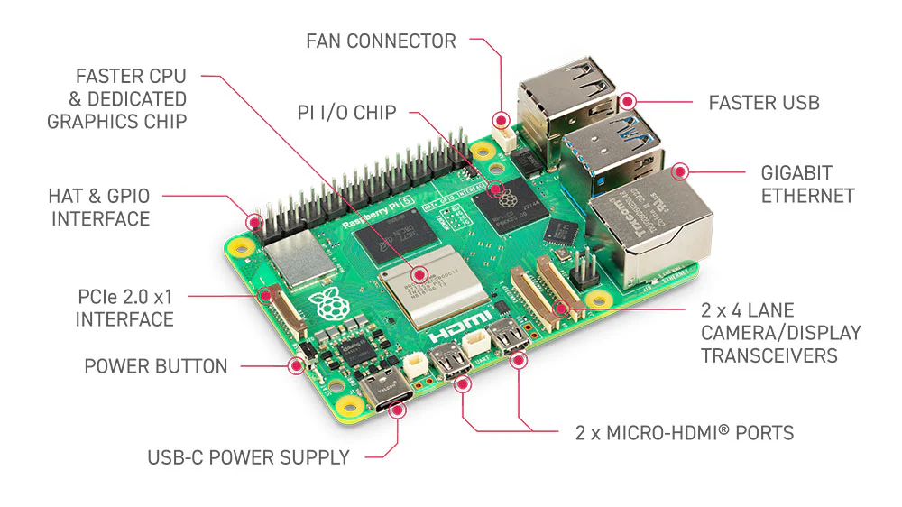
Raspberry Pi 5 (The Brain)
Think of the Raspberry Pi 5 as the “brain” of the drone. It processes information, makes decisions, and controls the other parts to keep the drone stable and follow commands. It runs programs and gathers data from sensors, which helps it decide things like speed, direction, and altitude.

Slide 4
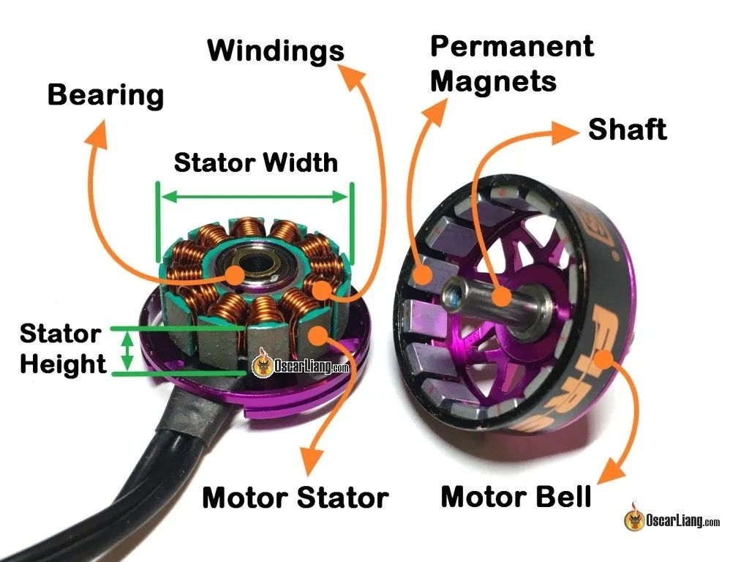
Motors (The Muscles)
Motors are like the “muscles” of the drone, making it move and stay in the air. Each motor spins a propeller, which pushes air downwards to lift the drone up. The faster the motors spin, the more lift the drone has. Our motors are Readytosky RS2205 2300KV Brushless Motors, which means they’re strong and built for fast, precise movements.

Slide 5
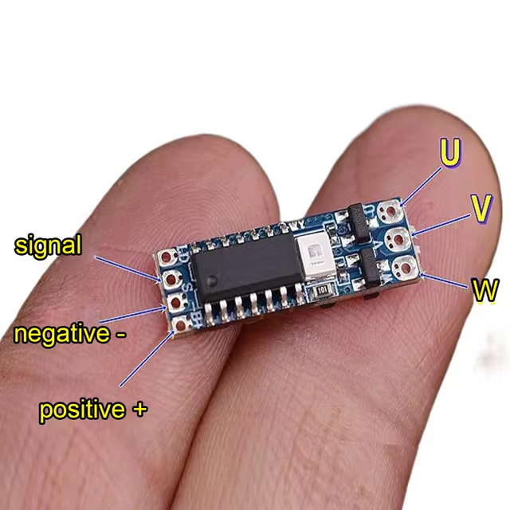
Motor Drivers (The Power Controllers)
Motor drivers, specifically our Cyclone 35A BLHeli_S ones, are like “controllers” that tell the motors exactly how fast to spin. They take instructions from the Raspberry Pi and give the motors the right amount of power to keep the drone balanced and responsive. These drivers help keep everything steady by controlling each motor’s speed accurately.

Slide 6
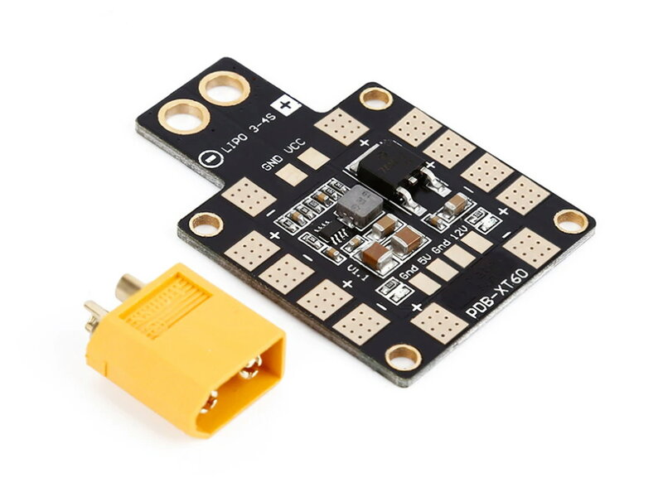
Power Distribution Board (PDB) (The Power Hub)
The PDB is like the “power hub” of the drone. It takes power from the battery and distributes it to all the other parts, so they don’t have to connect directly to the battery. This helps keep everything neat and avoids too many wires. Our Matek Mini Power Hub PDB even includes options for different voltages to power different parts safely.

Slide 7
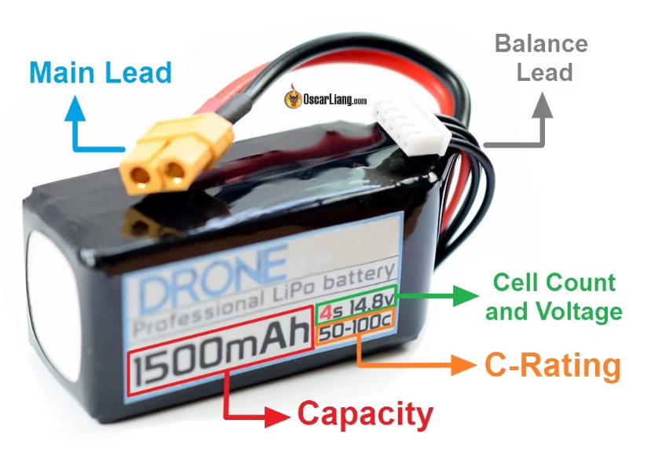
Battery (The Energy Source)
The battery is like the “fuel tank” of the drone, supplying electricity to all its parts. Most drones use rechargeable batteries that provide enough power for a flight, but they have to be recharged after each flight. We’re using a battery that works with the PDB and motor drivers to provide safe and reliable power.

Slide 8
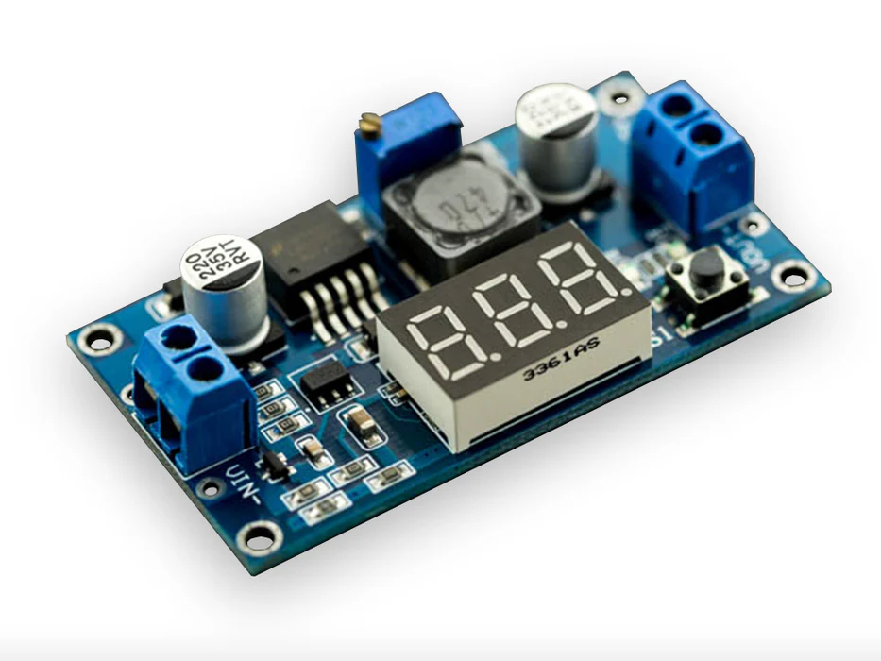
Buck Converter (The Voltage Adapter)
A buck converter is like an “adapter” that steps down the battery’s voltage to a safe level for the Raspberry Pi and other sensitive parts. Without it, the parts could get too much power and potentially get damaged. The buck converter ensures that each part gets the correct voltage it needs to operate safely.

Slide 9
Building Instructions
1. 3D Print the chassis
2. Assemble motors onto chassis using screws provided
3. Assemble the Raspberry Pi 5 onto chassis using screws provided
4. Assemble the PDB onto chassis using screws provided
5. Connect motor drivers to motors via pins
6. Clean up the wires using zip ties
7. Put on propellers
8. Download the App and connect
Now that you're equipped with the knowledge of drones and their electronic parts, it's time to take action! Embrace your inner engineer, experiment with designs, and most importantly, have fun flying. Remember, every flight is a new adventure waiting to happen. So, soar high and enjoy the journey!

Slide 10
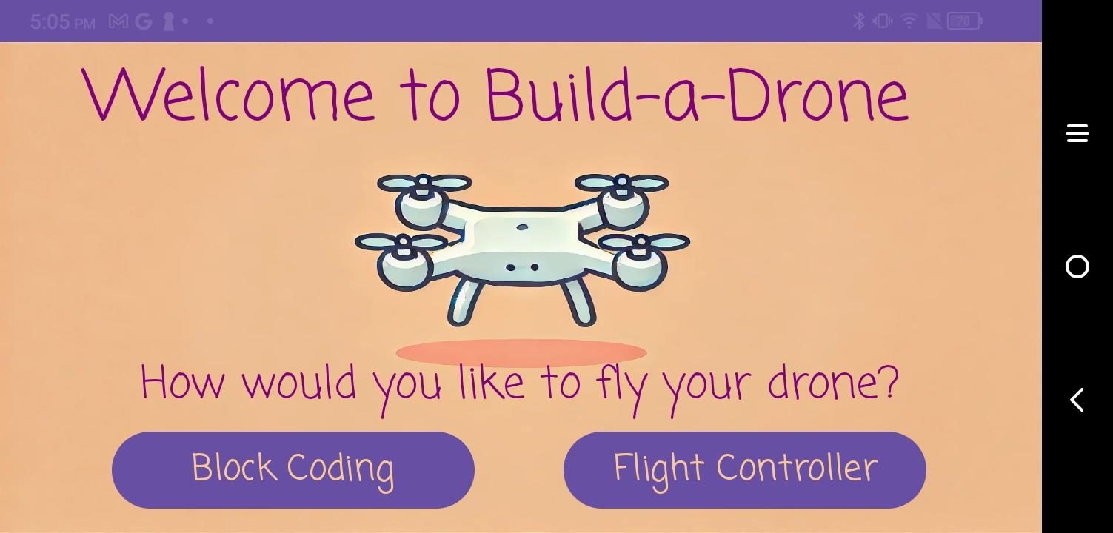
How to Use Our App
There are 2 ways to fly your new drone! Choose the 'Block Coding' option for an easier, more direct way to fly; choose the 'Flight Controller' option for a more experienced, interactive flight.

Slide 11
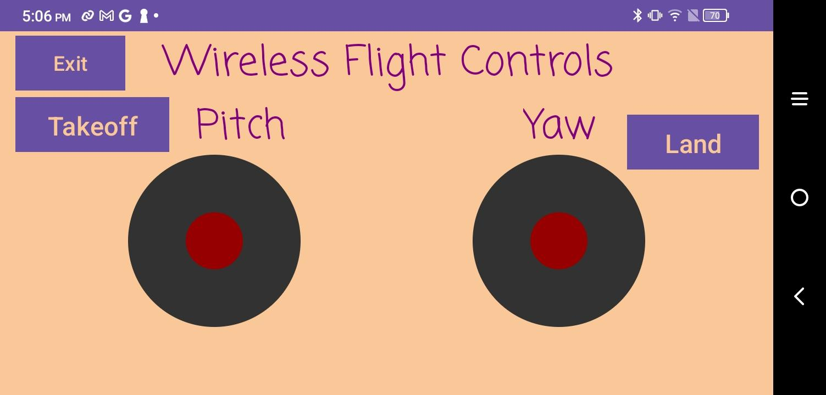
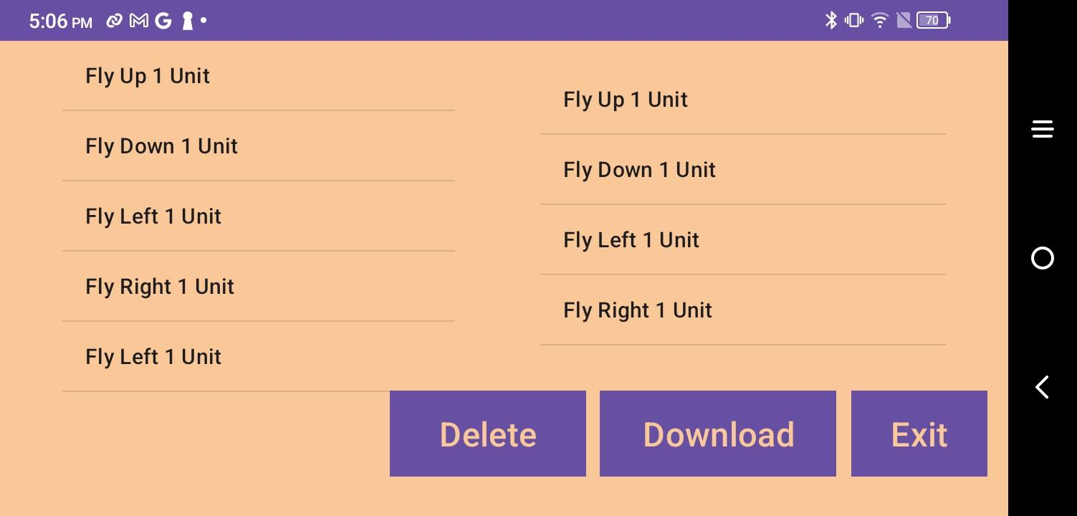
Flight Controller
Block Coding
There are two joysticks that you will use to fly your new drone. Use these joysticks like a traditional controller; the left joystick controls the pitch, and the right joystick controls the yaw. Select the takeoff button to takeoff. The drone will prepare and then begin to hover. Now it's your turn to take control—let's see if you're as skilled a pilot as you are an engineer! Once you are ready to land, return the drone to a safe landing location and press the land button. The drone will land itself safely.
Select a flying command on the right side of the screen, and the command will enter the command queue on the left. The drone will only take off if you input a safe command, i.e. 'up, left, right, down.' 'Up, up, up, left' is an example of an unsafe flight path. Use the delete button to remove commands from the queue. Once you are happy with your flight path, tap download and watch your creation take flight!

Slide 12
Clemson University
Holcombe Department of Electrical and Computer Engineering
Senior Design II: DIY Drone Kit
Grace Boccia, Kyle Buttermore, Chase Kinley, Josh White, & Langston Cooper
December 4, 2024

